Slide 1





Project Title
Online Furniture Marketing System

Slide 2
Under Supervision
Dr / Amira Seddik Elzeiny

Slide 3




Mohamed Nasr
Shrouq El-Sweesy
Rowida Mohamed
Omnya Azmy
Flutter Developer
Back End Developer
Back End Developer
Back End Developer
IT Department
CS Department
CS Department
IT Department
TEAM MEMBERS
Eslam El-far
Mazen El-Alfy
Sama Maged
Ahmed El-Sharabasy
Front End Developer
UI/UX Designer
FLutter Developer
Business Analyst
CS Department
IT Department
IT Department
IS Department
Team Leader

Slide 4
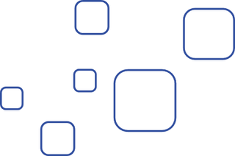

The Project Idea
1
We are developing a Mobile App and Website for furniture multivendor e-commerce platform

Slide 5
The Project Idea
2
Furniture Marketplace: Empowering Buyers with Price, Style, and Quality Comparison

Slide 6
The Project Idea
Empowering Sellers: Expand Your Reach and Boost Sales with Our Multivendor Platform
3

Slide 7
The Project Idea
Enhanced Shopping Experience: Personalized Recommendations, Wish Lists, and Price Alerts for an Engaging Journey
4

Slide 8
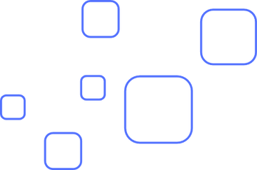


Problems
The Importance Of The Time Factor
Geographical Factor
Not available all time​

Slide 9
Problems
Not having all the buyer's needs in the Product
Lack of product information
Buyer's convenience to purchase

Slide 10





Solutions
E-Commerce
E-commerce, short for electronic commerce, refers to the buying and selling of goods and services over the interne
Developing Existing Systems
With the advancement of the websites of the electronic furniture business

Slide 11
Solutions
Very useful features for buyer
Classify all products and view as much information as possible about each product
There are images of each product from all angles with a video of the entire product details to inform all the details

Slide 12

Solutions
Finishing Property is very important and very useful for the buyer
This special is an expression of the availability of products before finishing and after finishing

Slide 13
Similar Systems Problems
Homzmart
Do not accept any claims arising from errors or omissions
It does not guarantee the quality, value or marketability of the products
Manzzeli
Prices may be higher compared to other online furniture stores in Egypt
Don't have ability to express opinion

Slide 14
Similar Systems
Smart furniture
The rooms are sold complete, non-controllable products.
The website does not offer international shipping
Tavolo Furniture
Limited customization options for furniture products
The return policy is not clearly stated on the website

Slide 15


System Name
Home Bazzar
Our Logo

Slide 16
Our advanced features over others Systems
More Information about each product
Product images from all directions
Video for each product showing all product details
Damietta Special Work

Slide 17
Our advanced features over others Systems
There are finished products and non-finished products features
Using Machine Learning to create a system that assembles all products associated with the browsed product

Slide 18
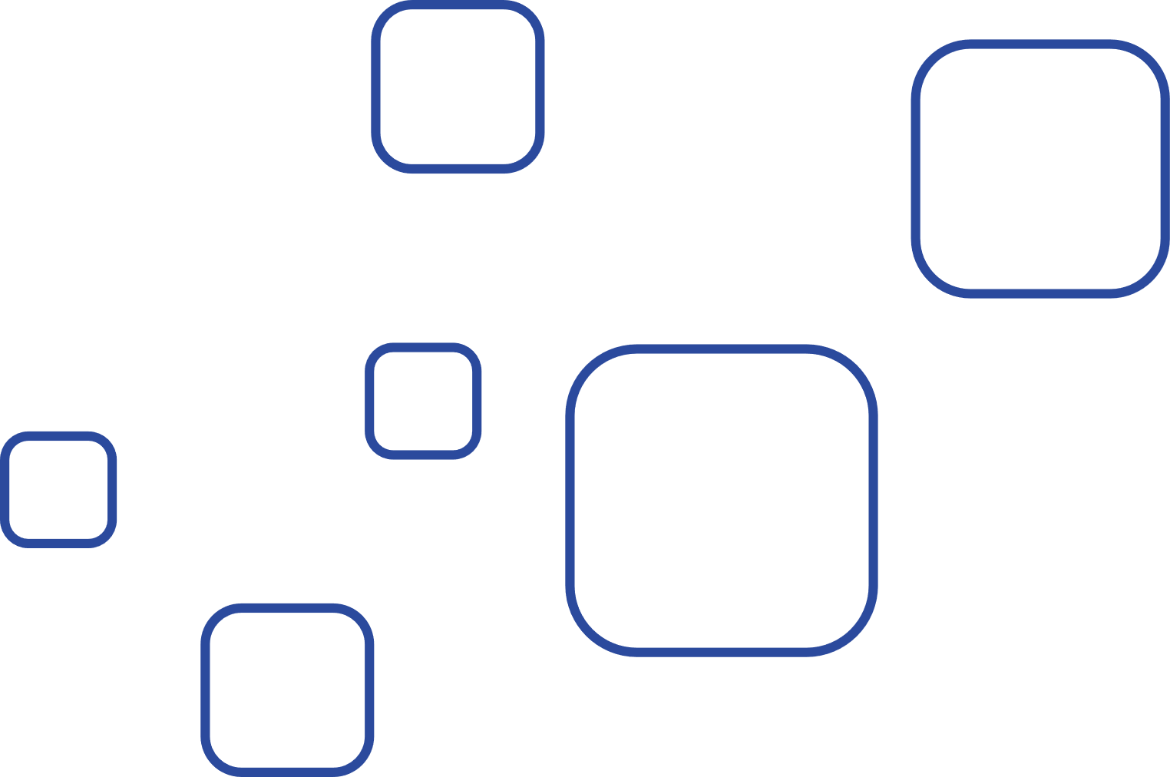
Implementation
Web Application & Mobil Application
We have created and developed a website and mobile app with the same business idea We will explain the whole system through the website and not the app

Slide 19
Applicability and connectivity
Social Sharing and Reviews
Seamless Mobile Experience
Chat and Support

Slide 20
Applicability and connectivity
Secure Payments and Buyer Protection
Product Customization

Slide 21
Future Work
Implement a recommendation system
Add 3D images
Expand the product range

Slide 22
Future Work
Implement augmented reality (AR)
Implement data analytics

Slide 23



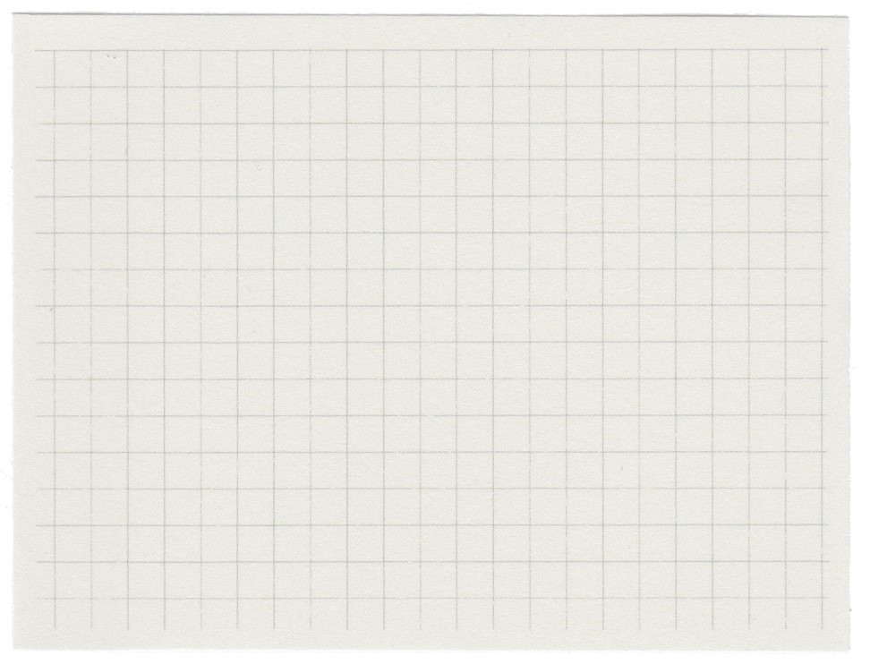



THANK
YOU

